Slide 1
Advanced Design Methods (MDO, KBE) AE4233
Dr.ir. G. La Rocca
Dr.ir. H.A. Visser
Ir. D. Steenhuizen
Dr. A. Elham
Flight Performance & Propulsion Group (FPP)
Remarks on optimization efficiency

Slide 2
Contents of this lecture
Problem size
Penalty functions
Example how not to formulate an optimization
Normalization of variables

Slide 3
Contents of this lecture
Problem size
Penalty functions
Example how not to formulate an optimization
Normalization of variables

Slide 4
Keep function evaluations to a minimum
Computational time required for a given optimization problem is strongly correlated to the number of times a given evaluation is required and, of course, by its complexity.
Complexity determines the relation between the number of design variables and the required computational steps:

Slide 5
Calculation complexity
Complexity of the calculation and, hence, computational time is determined by the number, diversity and type of relations that are implemented in an analysis-model.
Iterations, involving multiple calls to a single function, tend to be a cause of long computational times. Note that a (sub-) optimization in itself is an iterative process.
Non-linear equations take more effort to solve than linear ones.

Slide 6
Keep size of the problem manageable
Size of an optimization problem is determined by the number of design-variables, the number and type of constraints and the complexity of the analysis-modules involved.
The ‘size’ of the problem tends to drive the computational requirement. The bigger the size of the problem, the more computations required.
Hence, keeping the number of design-variables and constraints low is a very effective method of reducing the computational time

Slide 7


Gradient-based methods; finite differencing

Slide 8
Gradient-based methods; finite differencing
A gradient-based optimization algorithm will not only use the local objective-value of a given ‘test-design’, but also its gradient and even its second-derivative characteristics to steer towards the most optimal solution.
This determination of the derivative (the Jacobian-matrix) and 2nd derivative (the Hessian-matrix) information has a large influence on the number of variable evaluations of the optimization-problem.
For an evaluation of the gradient of the objective-function, usually N+1 evaluations of the objective function are required with a finite-differencing scheme

Slide 9
Gradient-based methods; finite differencing
For an evaluation of the 2nd derivative information, an approximation method can be employed that re-uses the previous objective and constraint function evaluations.
While obviously performed on the objective function, also the constraint-functions undergo almost the same evaluation-scheme (value, Jacobian) for every ‘test-design’. Note the added computational effort.
If the Jacobian and Hessian information can be directly provided by a function that accompanies the objective, a large gain in computational-time can be achieved.

Slide 10
Constrained vs Unconstrained Optimization
An unconstrained optimum is faster to find than a constrained one.
For the evaluation of the optimality-criterion (the KKT-condition) , both the objective-function and the constraint functions need to be evaluated for a constrained optimum.
For an unconstrained optimum, only the objective-function needs to be evaluated.
Thereby, methods have been developed to transform constraints into extra mathematical terms of the objective-function: e.g. Penalty-functions. (See reader sec 2.2.5., p. 43 - 45)

Slide 11
Contents of this lecture
Problem size
Penalty functions
Example how not to formulate an optimization
Normalization of variables

Slide 12
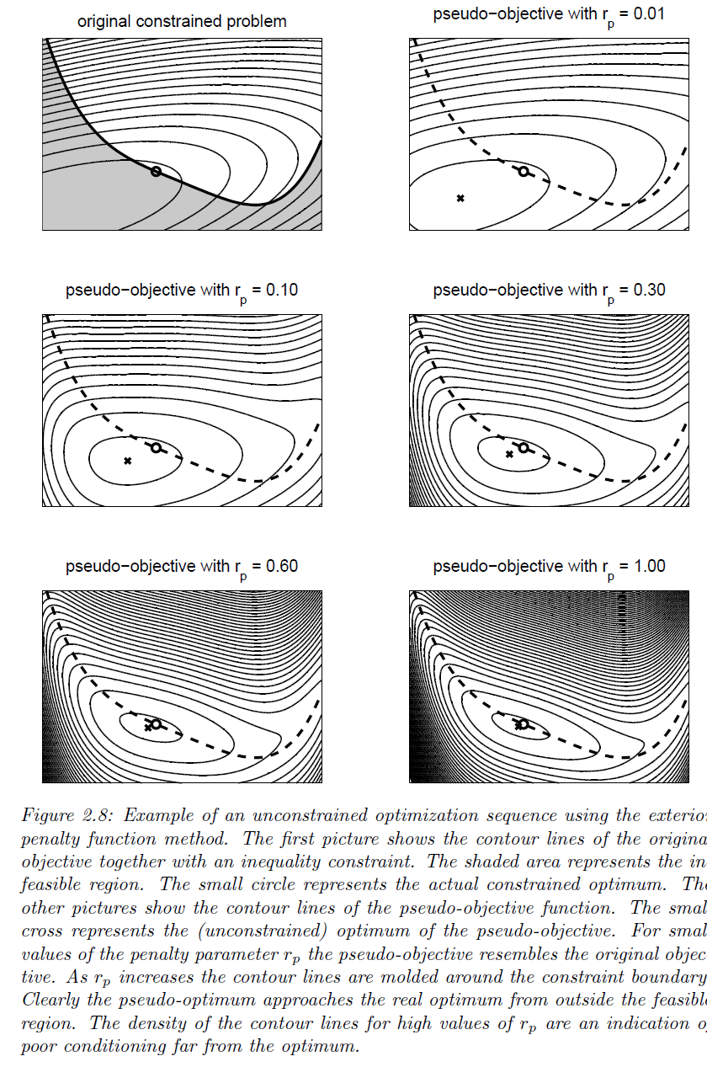
Constrained Optimization: Penalty functions

Slide 13
Penalty functions:
Penalty functions are a method to convert constraints (h_{i}, g_{i}) into extra terms of the objective function, J(x)
Penalty functions serve to introduce a “constraint barrier” in the objective function’s response. This barrier serves to “guide” the search process for the optimum value
Penalty functions have a variable weighting r_{p} in J(x), which should be lowered to 0 as the search routine approaches the optimum

Slide 14
Adding a penalty term to the objective
J(x) = f(x) s.t. g_{i}(x) > 0
J(x) = f(x) + r_{p} * -1/g_{i}(x)
This is just one mathematical ‘recipe’ for a penalty function. There are others as well

Slide 15
Penalty function at work

Slide 16
Penalty function at work

Slide 17
Penalty function at work

Slide 18
Penalty function at work

Slide 19
Penalty function at work

Slide 20
Penalty function at work

Slide 21
Contents of this lecture
Problem size
Penalty functions
Example how not to formulate an optimization
Normalization of variables

Slide 22
Example: How not to formulate an optimization-problem
Consider the fitting of an airfoil that is parameterized with the CST-method (this optimization-example will be elaborated in Practical1):

Slide 23
Example; design vector
For the CST-method, separate coefficients are required to describe the bottom and top portions of the wing
This gives a distinction between upper and lower surface variables:

Slide 24
Example: adding a constraint
Now that this optimization is properly defined (note no constraints), it can be optimized.
However, if the extra constraint of a symmetric airfoil is imposed, some interesting options are open to the programmer.
Requiring the design Bernstein-coefficients to give a symmetric result, means that a given Benrstein polynomial is exactly opposite to its counterpart on the adjacent surface:

Slide 25
Directly adding a constraint to the optimization definition
To implement airfoil symmetry in the original problem, one could proceed by adding a set of constraints to the optimization problem:

Slide 26
Directly adding a constraint to the optimization definition
As result of this approach, an additional set of N/2 constraints needs to be evaluated at each iteration-step!!
Because of the large number of constraints, it will take more evaluations to find an optimum. Hence, for the same initial search point, the total number of iterations needed will increase.
Obviously, this approach will increase the computational effort of the problem

Slide 27
A different approach: implement the constraint directly in the objective function
Let’s try to implement the symmetry constraint directly into the objective function:

Slide 28
A different approach: implement the constraint directly in the objective function
By introducing the constrained objective-function f_{constr}, the symmetry requirement is automatically satisfied for every ‘test’-vector x.
Incidentally, the number of design-variables has been cut in half from N to N/2. Also, no extra constraint-functions had to be implemented
This approach results in a huge reduction of computational effort

Slide 29
Contents of this lecture
Problem size
Penalty functions
Example how not to formulate an optimization
Normalization of variables

Slide 30
Normalization
In a purely mathematical sense, the absolute magnitude of the treated variables, objective and constraints is irrelevant
However, when implementing an optimization in a computational setting, these magnitudes become an issue, due to finite machine accuracy
Normalization of values is employed in order to prevent errors arising from this finite accuracy

Slide 31
Example: order of magnitude
Consider an optimization of a new A320-ish aircraft. The following optimization is defined: J(x) = W_{MTO}(S,A,W_{fuel}) s.t. g₁(x) = R(x) > 6.0 * 10⁶ m g₂(x) = n_{ult}(x) > 3.75

Slide 32
Example: order of magnitude
Now, assuming that the optimum design point does not lie very far from the A320, consider the typical magnitudes of the different values involved: A ~ 8 S ~ 125 m² W_{fuel} ~ 200,000 N R ~ 6.0 * 10⁶ m n_{ult} ~ 3.75 W_{MTO} ~ 800,000 N
5 orders of magnitude difference !

Slide 33

Problem before normalization

Slide 34

Problem after normalization

Slide 35
How to normalize variables
A|_{norm} = A/A_{ref}
S|_{norm} = S/S_{ref} W_{fuel}|_{norm} = W_{f}/W_{f_ref} R|_{norm} = R/R_{ref} n_{ult}|_{norm} = n_{u}/n_{u_ref} W_{MTO}|_{norm} = W/W_{ref}
A_{ref} 8 S_{ref} 125 m² W_{f_ref} 200,000 N R_{ref} 6.0 * 10⁶ m n_{u_ref} 3.75 W_{ref} 800,000 N
J(x) = W_{MTO}(S,A,W_{fuel}) s.t. g₁(x) = R(x) > 6.0 * 10⁶ m g₂(x) = n_{ult}(x) > 3.75
J|_{norm}(x|_{norm}) = W_{MTO}|_{norm}(S|_{n},A|_{n},W_{fuel}l_{n}) s.t. g₁(x|_{n}) = R|_{n}(x|_{n}) > 1 g₂(x|_{n}) = n_{ult}|_{n}(x|_{n}) > 1

Slide 36
Normalization
After normalizing the problem, the magnitude of all variables has become equal (around 1)
This will present the computer with a much “smoother” optimization problem, increasing accuracy and robustness

